Slide 1
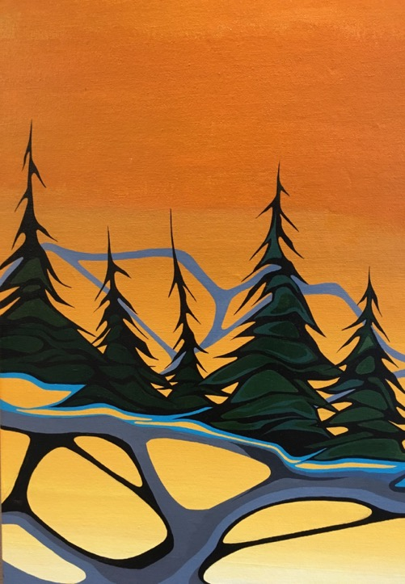

Shared
Decision‐Making
as a Solution
OBA Institute Panel
Lorraine Y. Land
Olthuis Kleer Townshend LLP
February 5, 2019

Slide 2
What Conditions Lead to
Successful Shared Decision-Making?
Your sovereignty. Your prosperity. Our mission.

Slide 3
The Ideal Shared Decision-Making Context:
The Parties have common – or parallel and non-competing – goals
The Parties are able to establish a trust relationship
Negotiators are willing to think creatively and flexibly
There are resources available for full mutual participation
From an Indigenous community’s perspective: it enhances self-determination and connections with culture and traditional lands and resources
Your sovereignty. Your prosperity. Our mission.

Slide 4
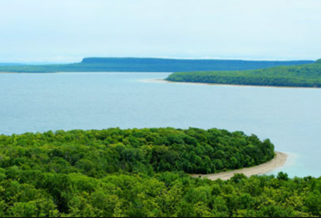
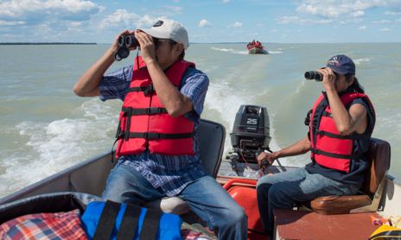
Two Illustrative Examples of
Successful Shared Decision-Making
Nochemowenaing (Ontario Heritage Trust and Chippewas of Nawash)
Environmental Management Agreements With Indigenous Guardians
Your sovereignty. Your prosperity. Our mission.

Slide 5
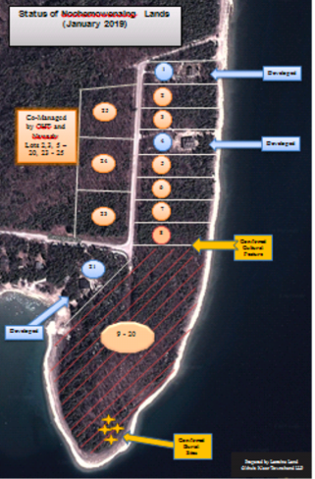
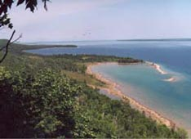
Nochemowenaing
… from conflict to co-management …
Your sovereignty. Your prosperity. Our mission.

Slide 6
What makes Nochemowenaing a
successful shared decision-making model?
Mutually compatible goals of OHT and Nawash
OHT’s ability to move quickly and be adaptable
Time and energy devoted by the Parties to establishing trust and long term relationships
Provided a practical solution to de-escalate a very volatile conflict situation
Ontario / OHT resources for land acquisition & a modest amount for co-management costs
Has become a key component of community education and cultural recovery efforts
Your sovereignty. Your prosperity. Our mission.

Slide 7
Challenges of the Nochemowenaing
shared decision-making model
Maintaining relationships (key to trust)
Anishinaabe law requires the community to personally steward the ancestral remains – how does that fit with co-management?
May not easily replicable if the non-Indigenous partner is a ‘normal’ Crown department rather than an arms-length agency/tribunal
Ongoing financial resources required
Your sovereignty. Your prosperity. Our mission.

Slide 8
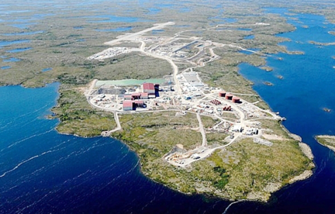
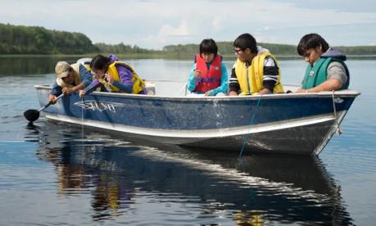
Northern EMAs with
Indigenous Guardian Programs
Snap Lake Diamond Mine
Dehcho K’ehodi Program
… from consultation to participation …
Your sovereignty. Your prosperity. Our mission.

Slide 9
What Are Environmental Management Agreements with Indigenous Monitoring?
Now used for almost all large projects in northern Canada (mines, forestry, parks and increasingly wildlife management)
The EMAs are usually between First Nations / Inuit and industry for mines and forestry and are now integrated into the regulatory system
EMAs provide for FN participation in environmental decision-making for projects, with Indigenous monitors playing a key role in the adaptive management process
Your sovereignty. Your prosperity. Our mission.

Slide 10
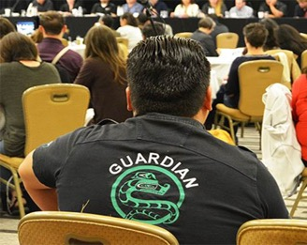
What Makes EMAs with
Indigenous Monitoring Successful?
They provide First Nations / Inuit with comfort that they will be fully involved in decision-making about lands and resources that are culturally critical
They resolve issues between the proponent or Crown, and the Indigenous group, on many matters that would otherwise involve regulatory hearing time and resources
They involve a combination of employment, cultural skills-building and community connections with traditional territories that ultimately enhance long-term cultural sustainability and Indigenous self-determination
Your sovereignty. Your prosperity. Our mission.

Slide 11
Why Should We Pay Attention in Ontario?
This model can help address the socio-economic-political gap between modern and historic treaty areas
See for instance Julie Jai’s analysis in Bargains Made in Hard Times: How Principles from Modern Treaties Can Reinvigorate Historic Treaties
They are becoming the national standard due to their success (for example, Parks Canada has instructed all National Parks to implement Indigenous Guardian programs)
Your sovereignty. Your prosperity. Our mission.

Slide 12
Beyond Shared Management
Indigenous-Crown shared management is not the end-point: it should be seen as a step on the road to Indigenous self-determination and recognition of Indigenous jurisdiction
Examples of the evolution of the northern co-management with the implementation of self-government agreements
Your sovereignty. Your prosperity. Our mission.

Slide 13
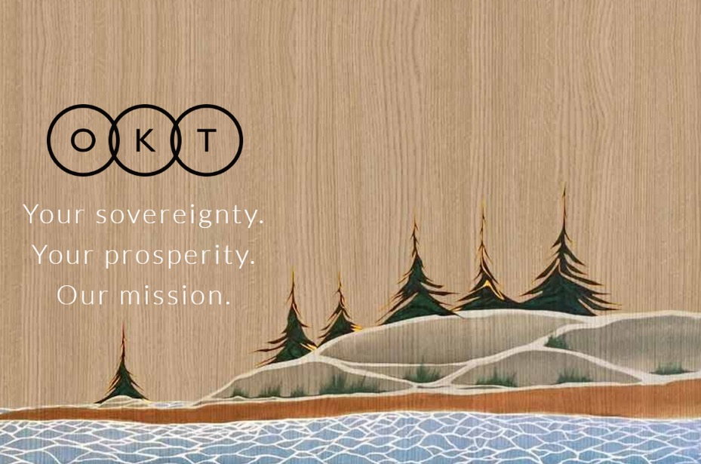
THANK YOU!
Lorraine Y. Land
416-981-9444
info@oktlaw.com
www.oktlaw.com

