Slide 1

Indigenous Law and Regulatory Frameworks:
The Evolving Landscape
PROSPECTORS & DEVELOPERS
ASSOCIATION OF CANADA
PDAC 2019

Slide 2
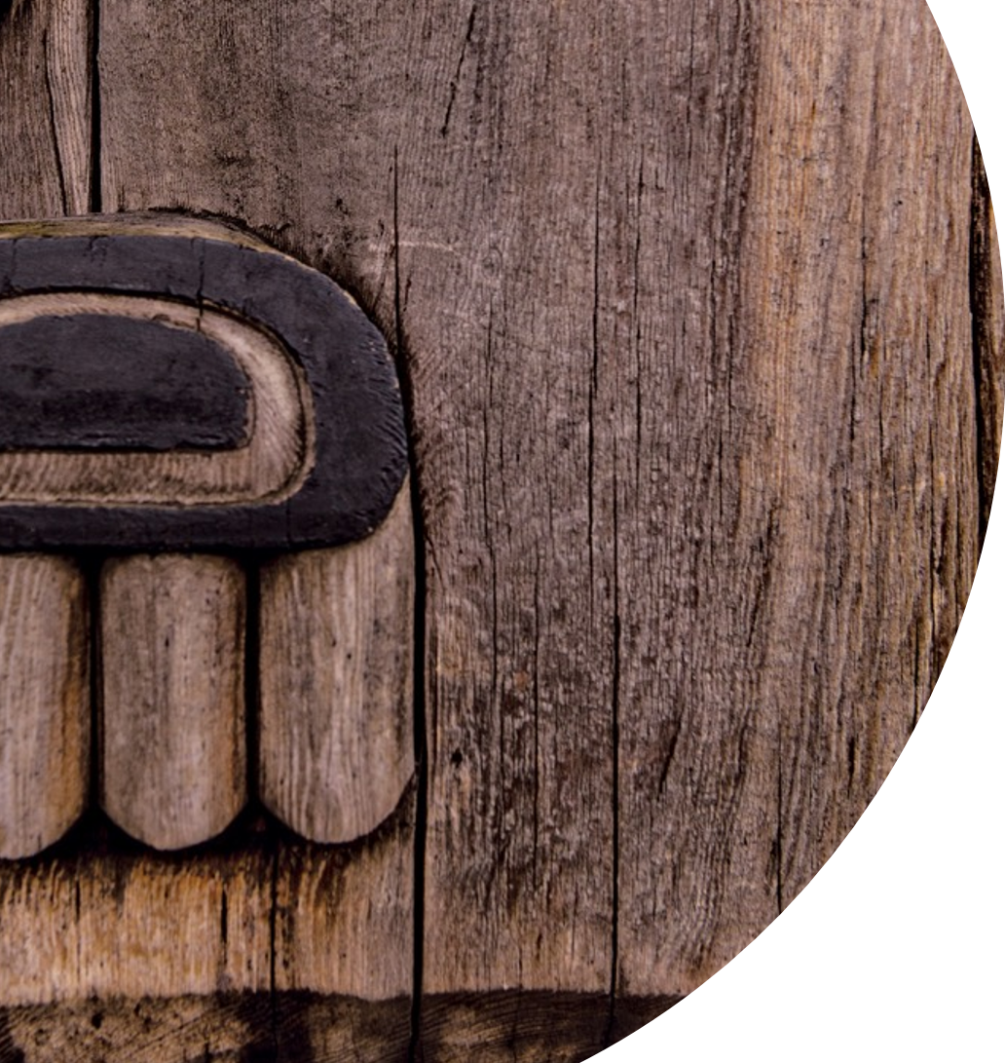
The Role of Environmental Assessment in Facilitating
or Achieving Free, Prior, Informed Consent (FPIC)
Ben Bradshaw, PHD Professor of Geography & Assistant Vice President
(Graduate Studies) University of Guelph
Celeste Haldane Chief Commissioner, BC Treaty Commission
Kevin O'Callaghan Partner, Fasken
Lorraine Land Partner, Olthuis Kleer Townshend LLP (OKT Law)
Mark Cliffe-Phillips Executive Director, Mackenzie Valley Review Board

Slide 3

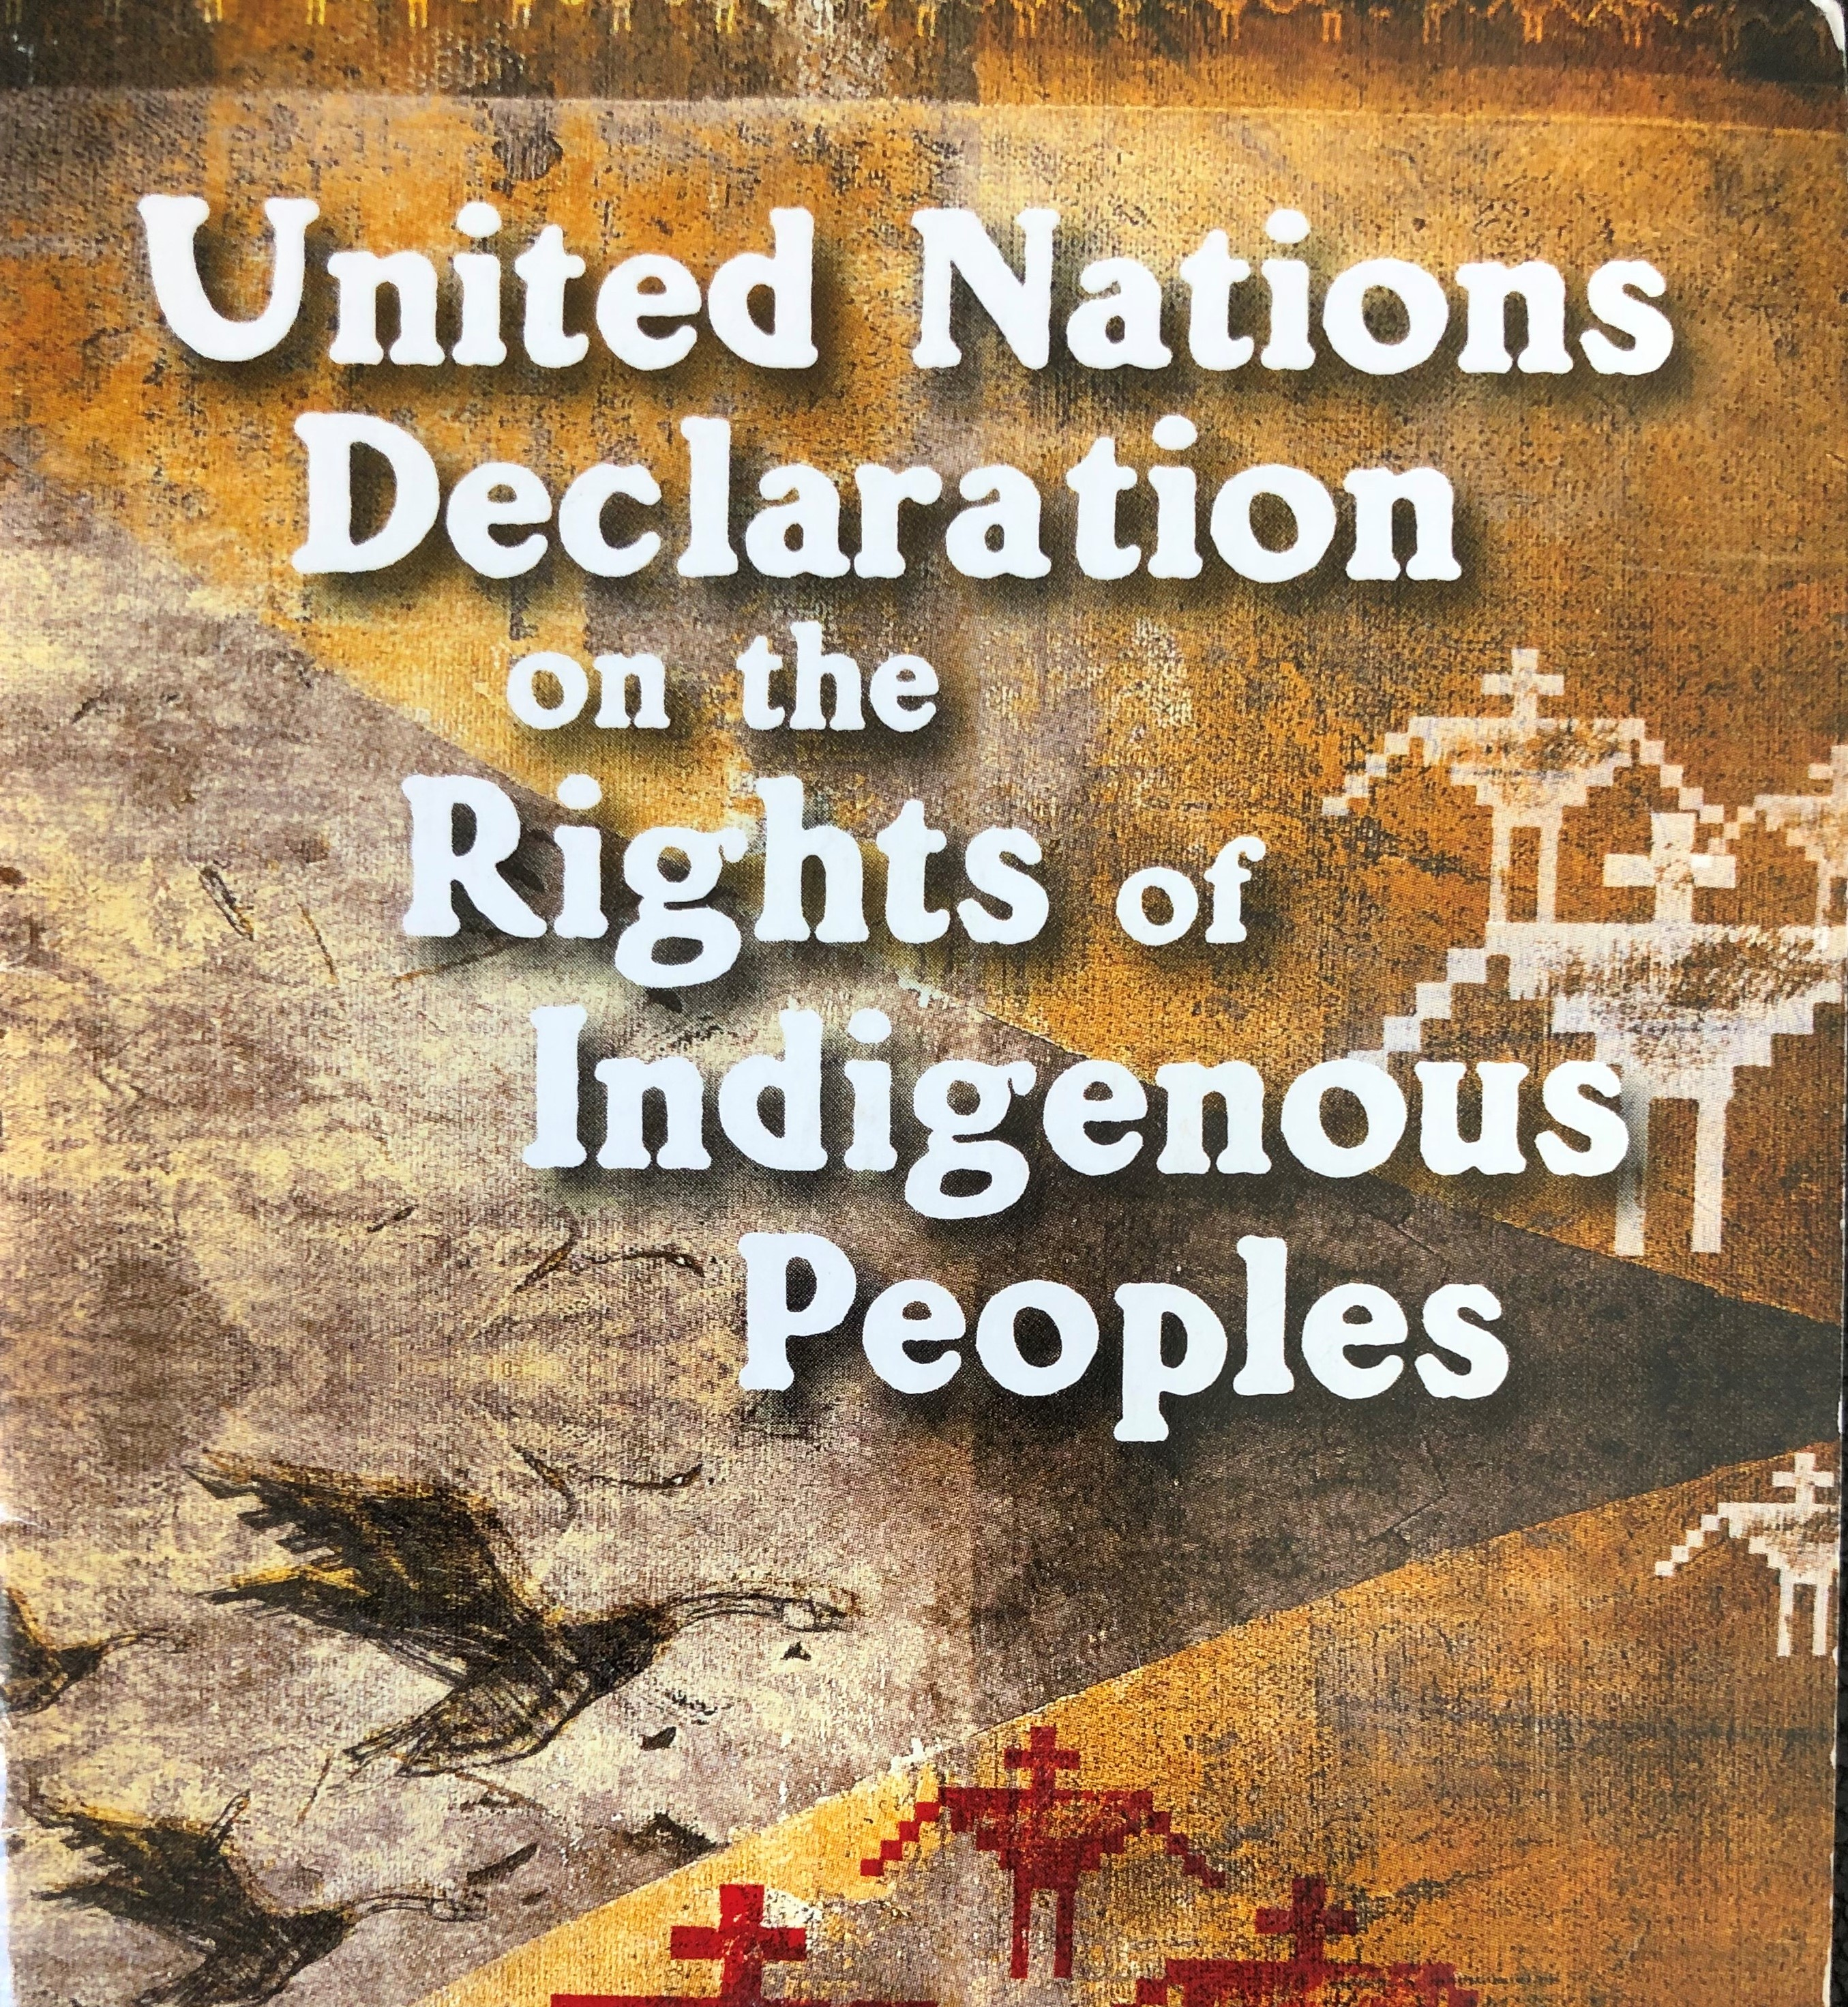

Slide 4
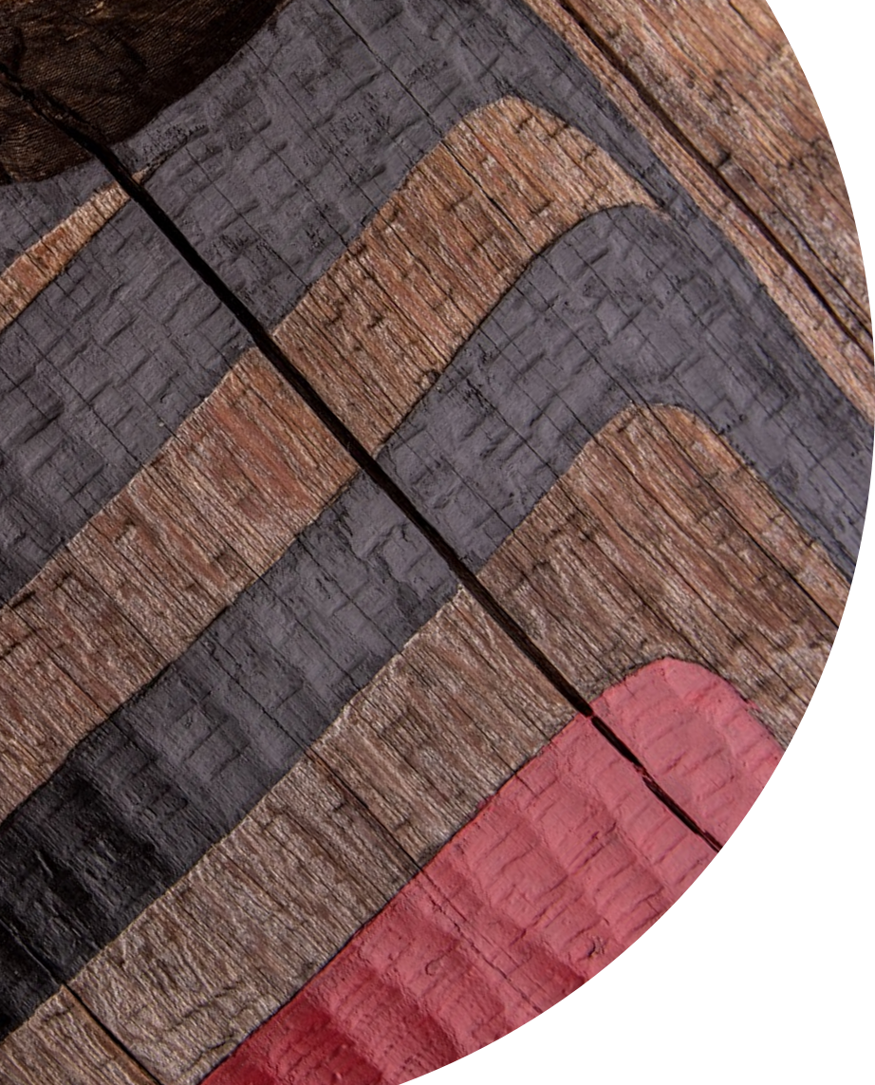
Origins Of The UN Declaration
and
Canada’s Endorsement
The UN Declaration on the Rights of Indigenous Peoples [UN Declaration] began with UN working groups as early as 1982.
2006, UN Human Rights Council accepts draft Declaration
2007 the UN Declaration was adopted by a majority of the UN General Assembly, Canada initially opposed the adoption.
The UN Declaration right to FPIC is in Article 32 (2):
  States shall consult and cooperate in good faith with the indigenous peoples concerned through their own representative institutions in order to obtain their free and informed consent prior to the approval of any project affecting their lands or territories and other resources, particularly in connection with the development, utilization or exploitation of mineral, water or other resources

Slide 5
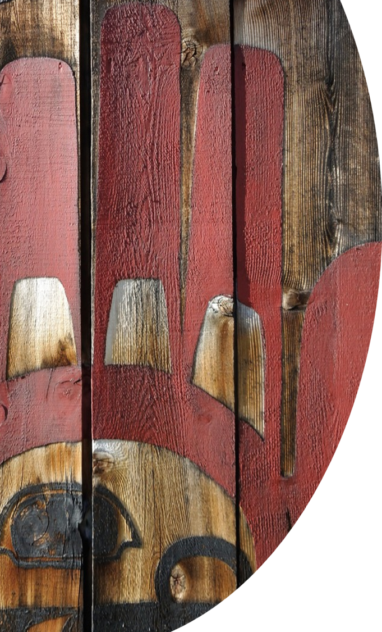
November 2010, Canada announced its endorsement with qualifications of the UN Declaration, referencing it an “aspirational” and “non-legally-binding” document.
May 2016, Canada fully endorsed the UN Declaration on following the election of the current federal government.
The endorsement continued the language used by the previous government that the UN Declaration be implemented in accordance with the Canadian Constitution.

Slide 6
Bill C-262
Bill C – 262, An Act to ensure that the laws of Canada are in harmony with the United Nations Declaration on the Rights of Indigenous Peoples (the “UNDRIP Act”)
Requires Canada, in consultation and cooperation with Indigenous peoples:
  Must take all measures necessary to ensure that the laws of Canada are consistent with the United Nations Declaration.
  Develop and implement a national action plan to achieve the objectives of the UN Declaration
  In addition, there will be an annual reporting to Parliament on the implementation.
Currently, in second reading in the Senate. The act affirms the UN Declaration as “a universal international human rights instrument with application in Canadian law.”
It remains to be seen what effect the passage of Bill C-262 will have on the courts.

Slide 7
Judicial Interpretation of FPIC in Canada
The concept of FPIC as it appears in the UN Declaration has not been considered by the courts.
Even where FPIC has been raised in argument, Canadian courts have been reluctant to consider it.
To date, no Canadian cases have treated the UN Declaration as imposing enforceable obligations, particularly as it concerns FPIC.

Slide 8
Conceptualizing FPIC
The UN Declaration does not establish a clear model for the shared governance and decision-making under which the rights set out in UN Declaration, including FPIC, can be exercised.
There are a number of complex questions underlying Article 32 that will need to be answered, including:
    What are the mechanisms for governments to consult and cooperate in good faith to obtain FPIC?
    Who are the “representative institutions” of Indigenous Peoples?
    Are all impacts the same or will minor interferences be subject to a different standard of consent than major interferences?
    What are the “lands or territories and other resources” of Indigenous Peoples?
    How will overlaps or disputes between Indigenous groups over lands or territories be resolved?

Slide 9
Importantly, Article 32 does not address the interaction between the rights of Indigenous and non-Indigenous peoples, including the interests of the broader society.
In this regard, Article 46 (2) of the UN Declaration contemplates that Indigenous rights will be subject to limitations:
  The exercise of rights set forth in this Declaration shall be subject only to such limitations as are determined by law and in accordance with international human rights obligations. Any such limitations shall be non-discriminatory and strictly necessary solely for the purpose of securing due recognition and respect for the rights and freedoms of others and for meeting the just and most compelling requirements of a democratic society.

Slide 10
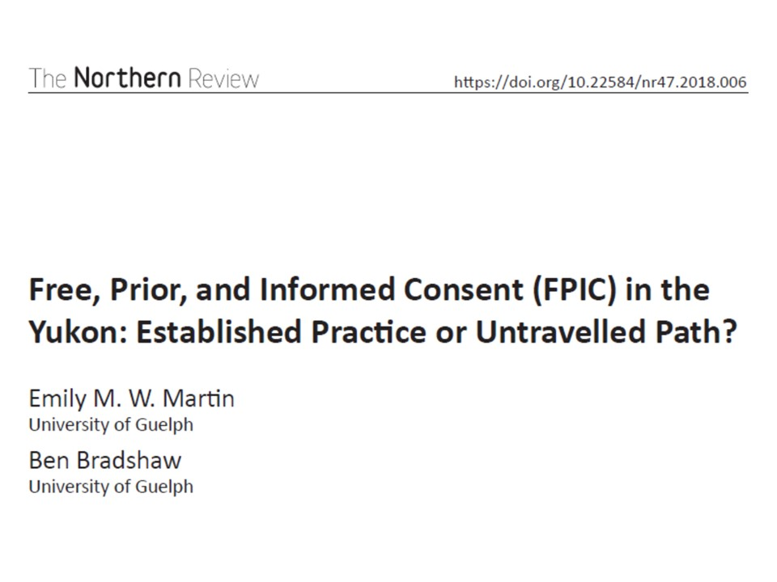

Slide 11
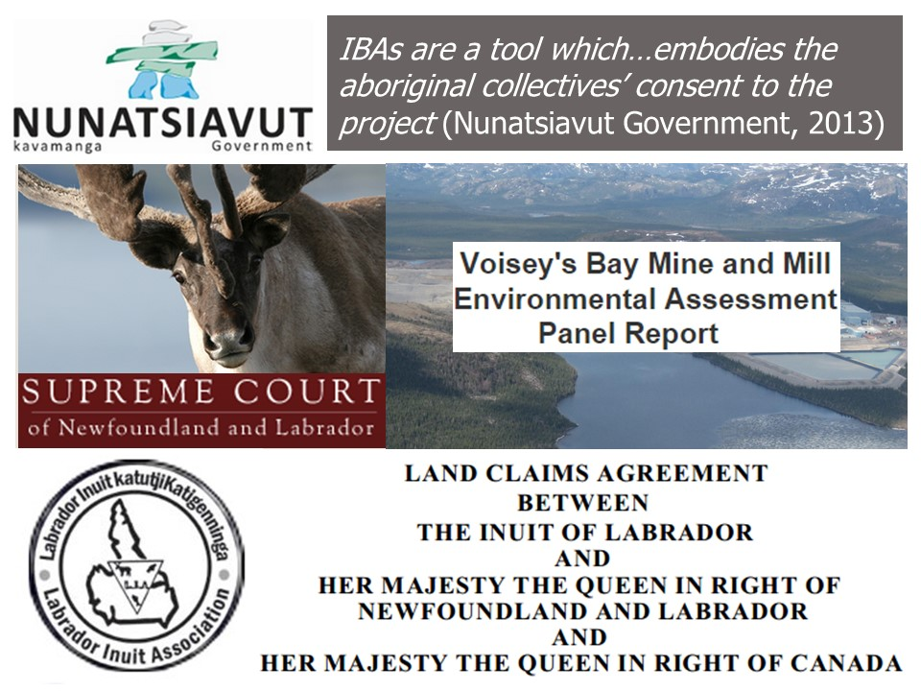

Slide 12
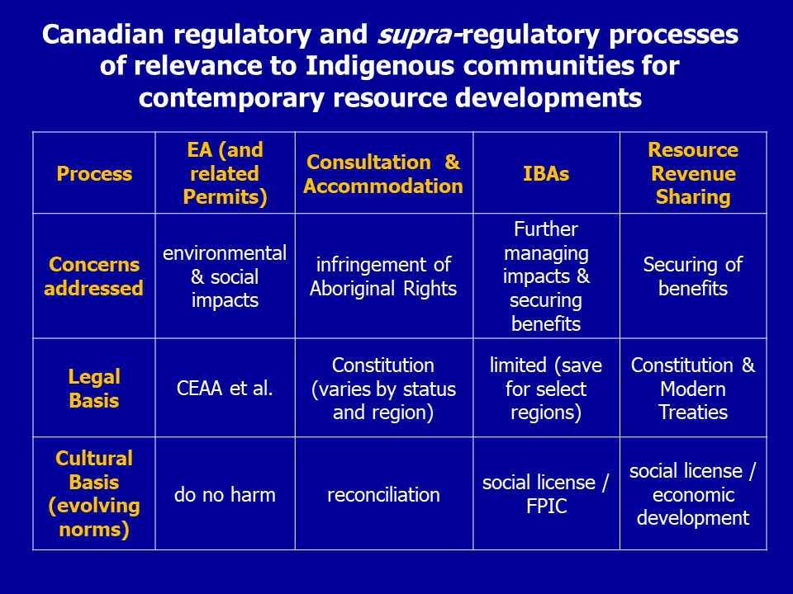

Slide 13


Slide 14
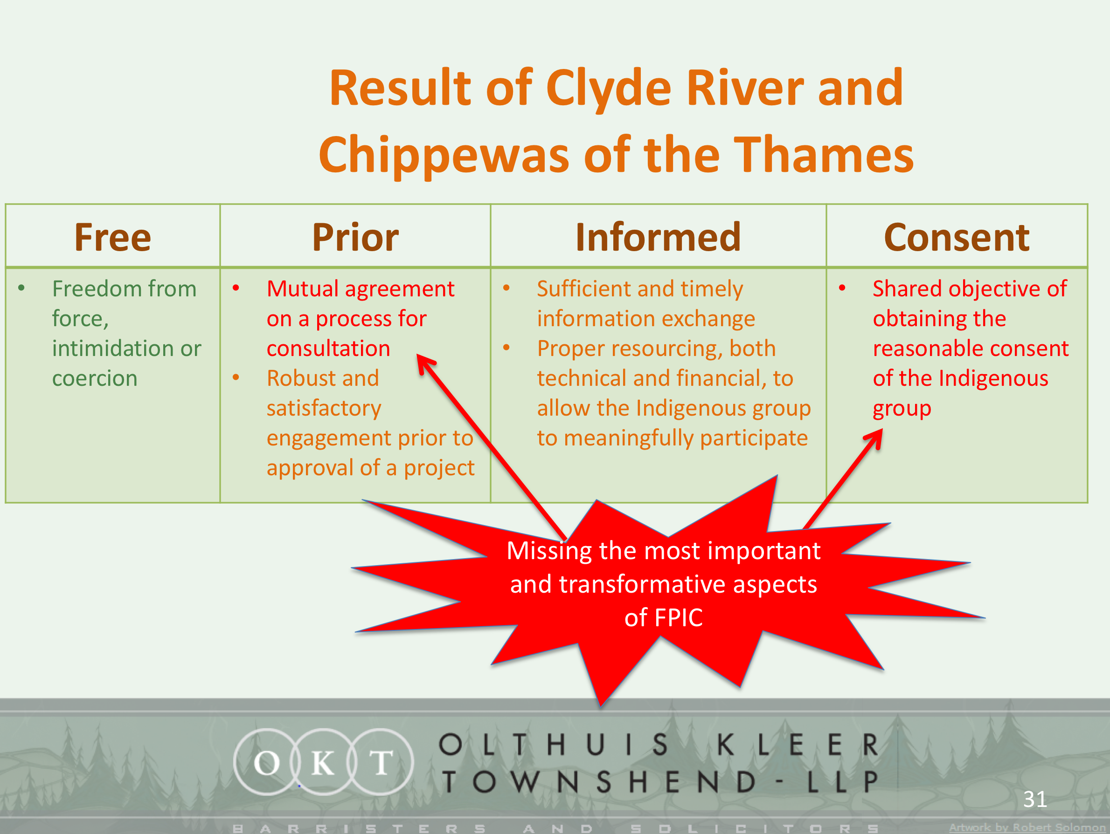

Slide 15
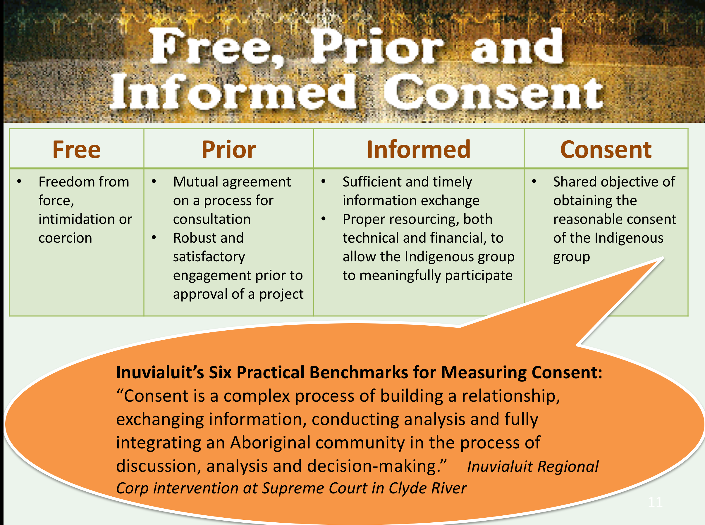

Slide 16
REFLECTIONS FROM THE PANEL

Slide 17
EA can facilitate the securing of Indigenous peoples’ Free, Prior and Informed Consent [FPIC] with respect to being informed prior to a consent decision
Lack of consent from affected Indigenous nations, due to unmitigable impacts on areas of cultural and spiritual significance, can result in the rejection of a project
Actual consent is better achieved elsewhere, including through negotiated agreements
The timing of EA participation/completion and IBA negotiations can sometimes be problematic. Result is that EA processes or sometimes ignored in favour of IBA negotiations
Growing trust in, and use of, EA by Indigenous Governments to help assess impacts of a project on the Indigenous peoples and the viability of mitigation measures
Participation in EA cannot be interpreted as tacit or predicted consent for a project
EA must further evolve to focus on Indigenous peoples’ priorities.
Many community-relevant well-being indicators have never been measured or modeled

Slide 18
Though EA processes in some jurisdictions are seeking to respond to this need, more work needs to be done to build trust in EA and to maximize its utility
Clyde River as a case study of the embedded components within FPIC to understand what FPIC-compliant processes should practically look like
Inuvialuit's approach to the component pieces of FPIC
Co-management led Environmental Assessment processes with a strong community and Indigenous world view focus has led to better informed communities and Indigenous organizations
There are EA’s where Indigenous Nations with Self Government rights have the ability to participate throughout, but also have final decision making authority to ensure their consent is required for the project to move forward and to the conditions.
Modern treaties can operationalize FPIC and UNDRIP
Modern treaties contemplate indigenous involvement in resource management and EA
The Nisga’a treaty used to empower consent based decision making in EA processes.

Slide 19
Operationalizing FPIC
http://www.bctreaty.ca/sites/default/files/LegalOpinion-FPIC-BCTC-2018.pdf

