Slide 1
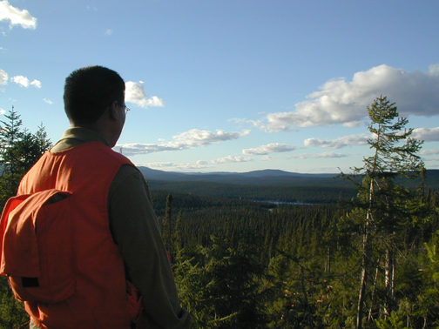
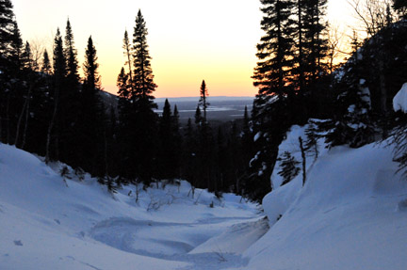
Recognizing Indigenous Rights
Indigenous Protected
and Conserved Areas
Larry Innes and Lorraine Land
North American Congress for Conservation Biology July 2018

Slide 2
Overview
The Opportunity
Legal Foundations
Moving Beyond Colonial Models
Creating Space for Indigenous Jurisdiction
“How To”
NOTE: The views and opinions expressed in this presentation are those of the authors, and do not necessarily reflect the views, policies or positions of any Indigenous government, representative organization or expert body.

Slide 3
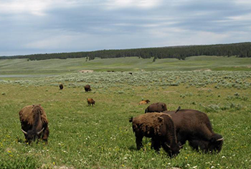
The Opportunity
There is strong evidence of correlation between secure Indigenous tenure and positive conservation outcomes -
Victoria Tauli Corpuz - Special Rapporteur’s Report to the UN General Assembly
Notes:
Increasing evidence supports the correlation between secure Indigenous tenure and positive conservation outcomes, at times better than those achieved in State-managed protected areas…significant expansion of areas under Indigenous management, coupled with solid partnerships with Indigenous peoples for knowledge exchange, remain key opportunities for States and conservationists to operationalize the participation of Indigenous peoples in conservation.”
Victoria Tauli Corpuz - Special Rapporteur’s Report to the General Assembly “Thematic analysis of conservation measures & impact on Indigenous peoples’ rights” 29 July 2016

Slide 4
The Opportunity
Moving beyond conventional, “top-down” approaches to managing parks by developing a framework that recognizes the significant contributions of Indigenous peoples
Notes:
Canada has an opportunity to move beyond the conventional, “top-down” approaches to designating and managing federal, provincial and territorial parks by developing a framework for the recognition of the significant contributions of Indigenous peoples to the protection of ecological and cultural diversity and the realization of national and international conservation commitments, including Aichi Target 11.

Slide 5
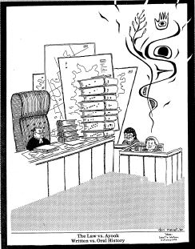
Reconciling Legal Foundations
Canadian
versus
Indigenous
legal traditions and worldviews
Notes:
Indigenous and Crown legal traditions start from fundamentally different foundations.
These perspectives have not yet been reconciled in law, policy or practice, and as a consequence, the “promise” inherent in s. 35 remains unfulfilled, even in modern treaties and agreements.
Parks and protected areas are in many ways reflections of the legal and political circumstances of indigenous peoples at the time they were created.

Slide 6
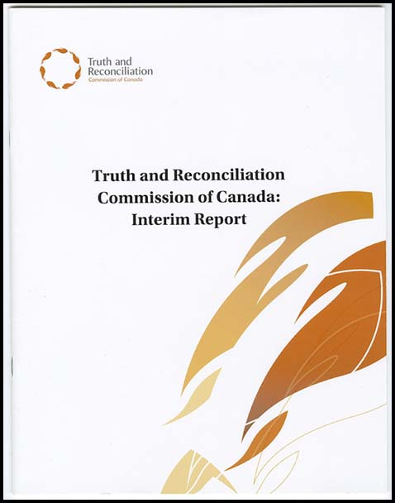
Colonial Law
“For over a century, the central goals of
Canada’s Aboriginal policy were to eliminate
Aboriginal governments; ignore Aboriginal
rights; terminate the Treaties; and, through
a process of assimilation, cause
Aboriginal peoples to cease to exist as
distinct legal, social, cultural, religious,
and racial entities in Canada. The establishment
and operation of residential schools were a central element of this policy, which can best be described as ‘cultural genocide.” - Final Report, Truth and Reconciliation Commission, 2015

Slide 7
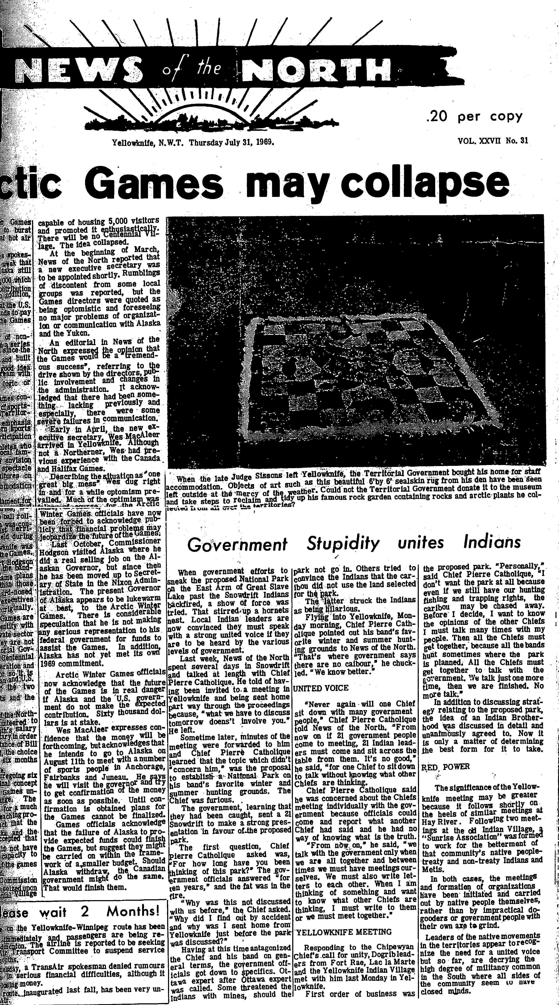
“Government Stupidity Unites Indians”
When government efforts to establish the proposed National Park on the East Arm of Great Slave Lake, a show of force was the result…
Local leaders are now convinced that they must take a united front to be heard by the various levels of government…
“News of the North”, July 31 1969

Slide 8
Getting to the Beginning
The fundamental objective of the modern law of aboriginal and treaty rights is the reconciliation of aboriginal peoples and non-aboriginal peoples and their respective claims, interests and ambitions…The management of these relationships takes place in the shadow of a long history of grievances and misunderstanding. – Mikisew Cree v. Canada [2005]

Slide 9
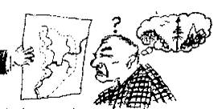
Indigenous Perspectives
“Land and benefits therefrom may be shared with others, and when Indian nations entered into treaties with European nations, the subject of the treaty, from the Indians' viewpoint, was not the alienation of the land but the sharing of the land.” - Professor Leroy Little Bear
Notes:
Indigenous peoples' law (as distinct from Canadian law) is uniform on the principle that lands and rights to land are not transferable and therefore are inalienable.

Slide 10
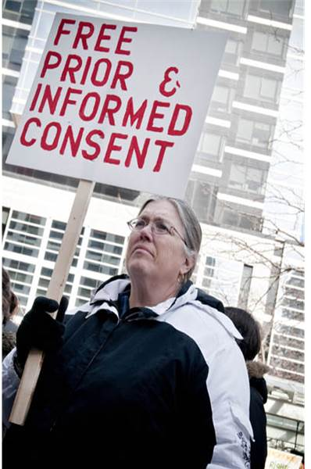
UNDRIP
UNDRIP Article 32:
States shall consult and cooperate in good faith with the indigenous peoples … to obtain their free and informed consent …
Notes:
States shall consult and cooperate in good faith with the indigenous peoples concerned through their own representative institutions in order to obtain their free and informed consent prior to the approval of any project affecting their lands or territories and other resources, particularly in connection with the development, utilization or exploitation of mineral, water or other resources.
Article 32 UN Declaration on the Rights of Indigenous Peoples (UNDRIP)

Slide 11
TRC Calls to Action
Repudiate concepts used to justify European sovereignty over Indigenous lands and peoples such as the Doctrine of Discovery and terra nullius.
Adopt and implement the United Nations Declaration on the Rights of Indigenous Peoples as the framework for reconciliation.
Renew or establish Treaty relationships based on principles of mutual recognition, mutual respect, and shared responsibility for maintaining those relationships into the future.

Slide 12
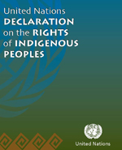
The Declaration is a visionary step towards addressing the human rights of indigenous peoples. It sets out a framework on which States can build or rebuild their relationships with indigenous peoples. … [I]t provides a momentous opportunity for States and indigenous peoples to strengthen their relationships, promote reconciliation and ensure that the past is not repeated.
UN Secretary-General (Ban Ki-moon), International Day of World’s Indigenous People”, SG/SM/11715, HR/4957, OBV/711 (23 July 2008).

Slide 13
Crown Policy in the Present
Historical assumptions about the role of Crown
Ensured Crown authority remained intact
Is reflected in existing parks and protected areas management
Notes:
The Crown has historically asserted sovereignty over all land and peoples – which our courts have accepted, without examining the substantive basis for the Crown's claims.
Crown approaches have been structured to ensure that the Crown decision-making and authority remain intact.
This is reflected in how existing parks and protected areas are managed under federal and provincial legislation.

Slide 14
Evidence of Change?
SCC direction: reconciliation
Tsilhqot'in decision
Budgets
TRC response
(including re UNDRIP).
10 Principles commitment to building ‘nation-to-nation’ relationships
Notes:
SCC direction that goal of Crown relationship with Indigenous peoples is reconciliation
Tsilhqot'in and Daniels decisions
Massive budget commitment to addressing Indigenous peoples’ needs
Federal commitments to address all TRC recommendations, including implementing UNDRIP.
Federal commitment to building ‘nation-to-nation’ relationships with Indigenous peoples in 10 Principles

Slide 15
Canada’s July 2017 10 Principles for Relationships with Indigenous Peoples
Principle 4:
The Government of Canada recognizes that Indigenous self-government is part of Canada’s evolving system of cooperative federalism and distinct orders of government.
Nation-to-nation, government-to-government, and Inuit-Crown relationships, including treaty relationships, include:
(a) developing mechanisms and designing processes which recognize that Indigenous peoples are foundational to Canada’s constitutional framework;
(b) involving Indigenous peoples in the effective decision-making and governance of our shared home;
(c) putting in place effective mechanisms to support the transition away from colonial systems of administration and governance…and
(d) ensuring, based on recognition of rights, the space for the operation of Indigenous jurisdictions and laws.

Slide 16
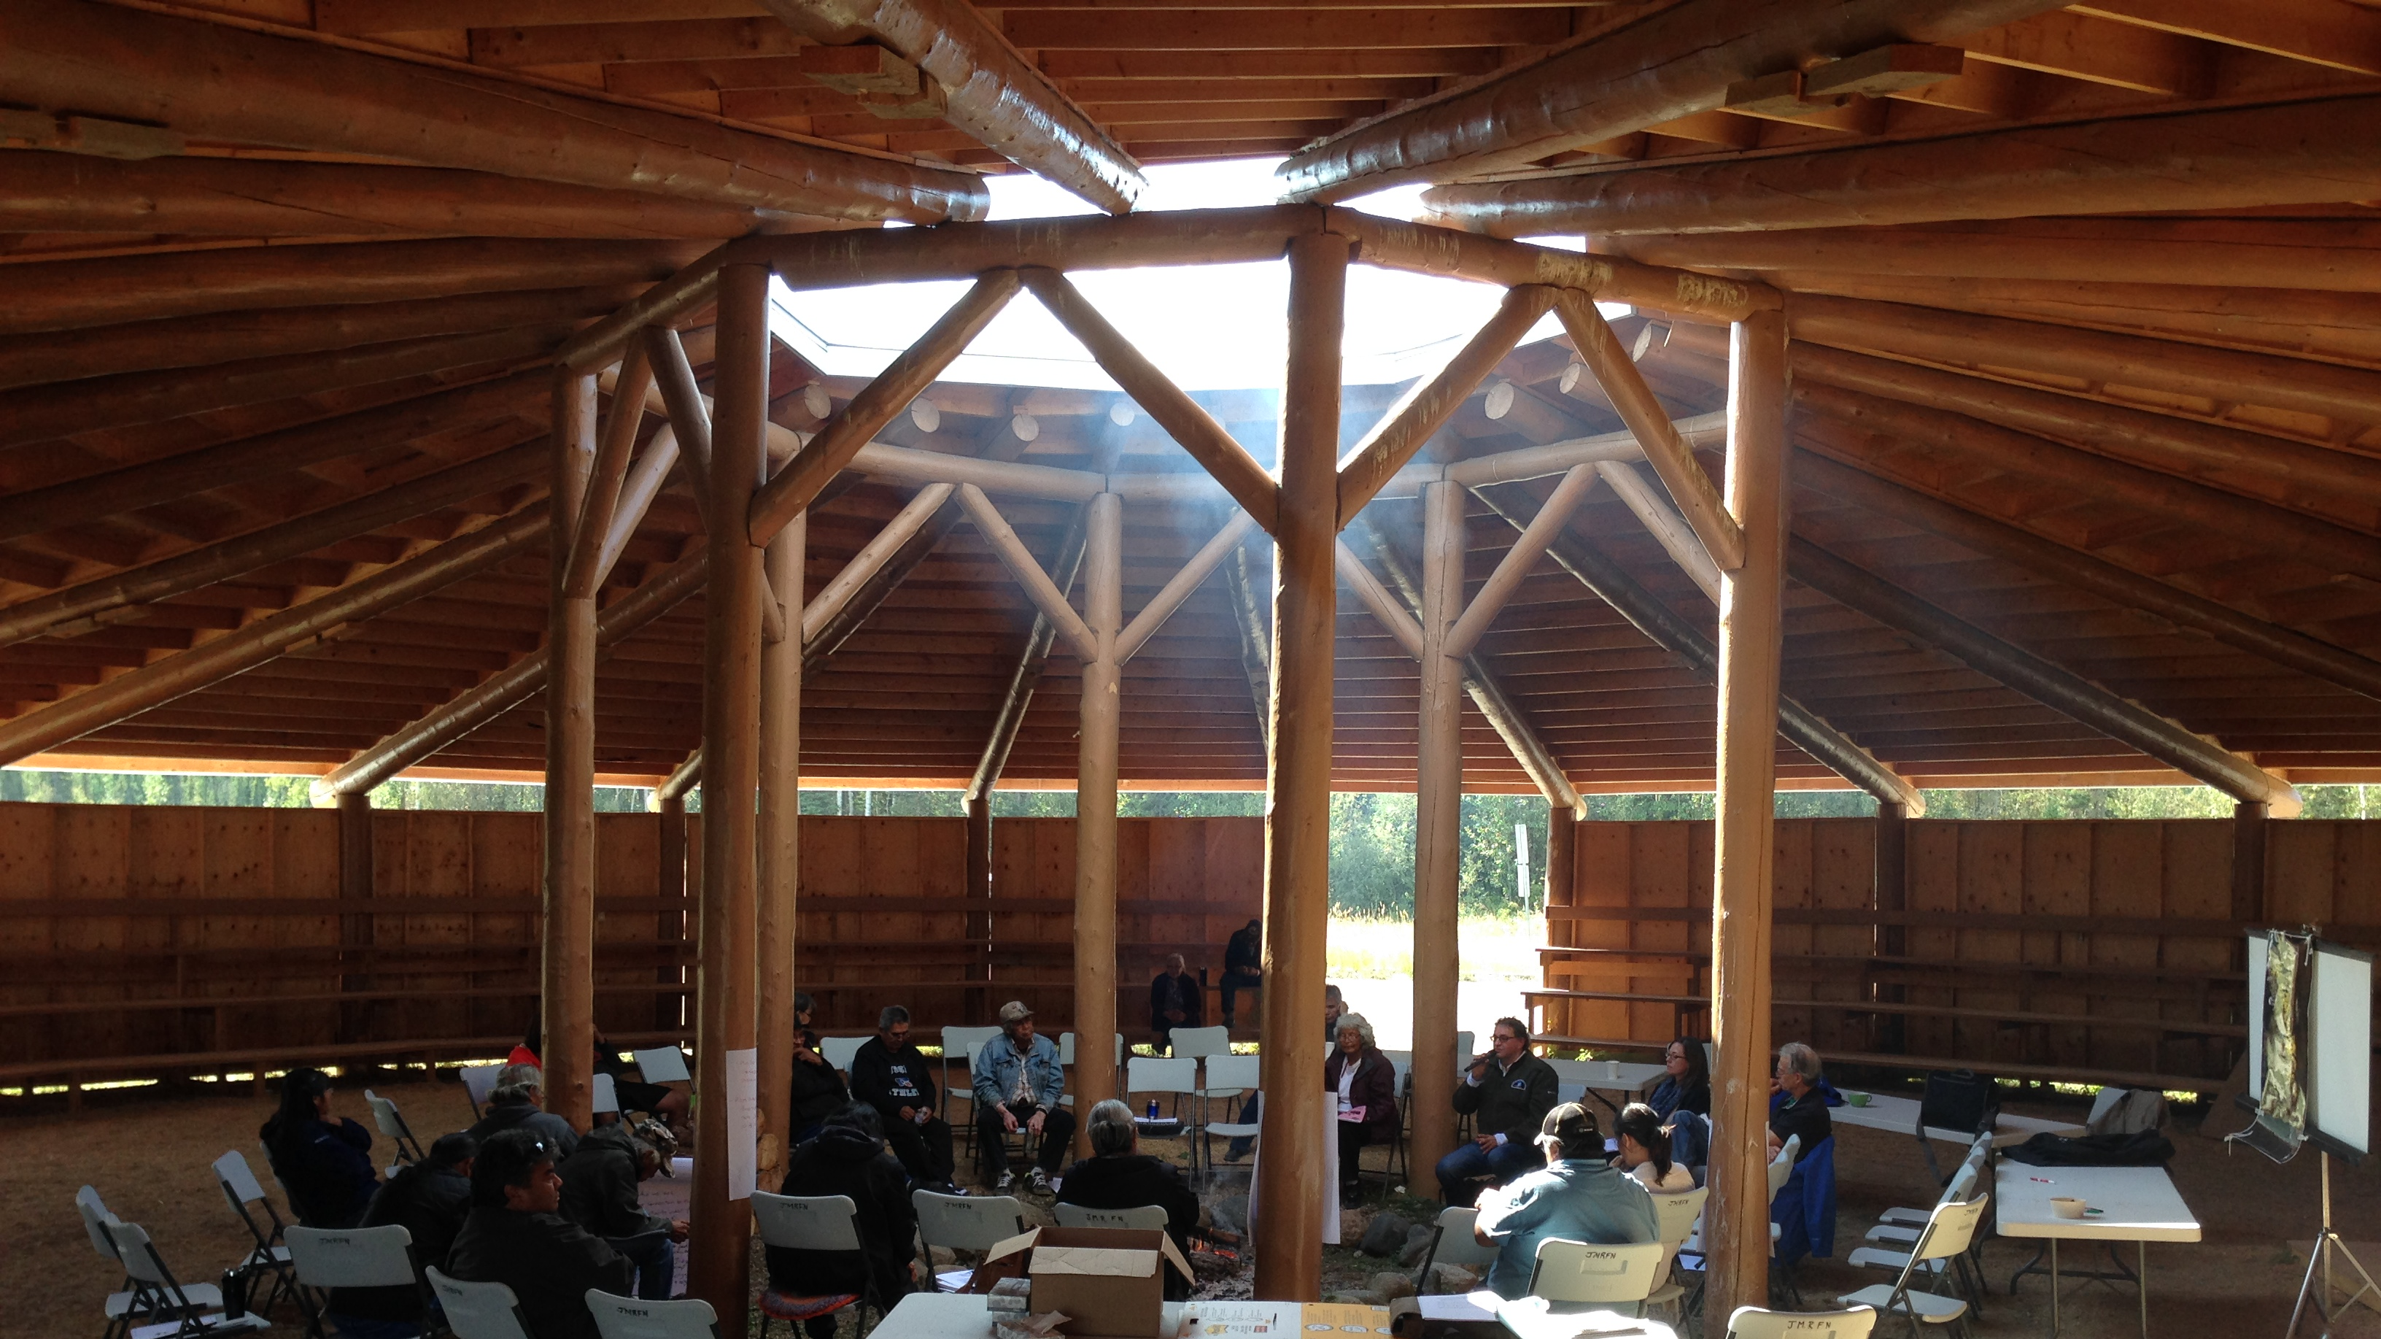
Indigenous Protected and Conserved Areas
From colonial systems of administration and control towards reconciliation, based on shared jurisdiction.
Notes:
Transition from colonial systems of administration and control towards reconciliation.
Basis for collaboration between Crown and Indigenous governments in the conservation and protection of our shared home.
Based on mutual recognition and shared/concurrent jurisdictions – space for operation of Indigenous jurisdiction and laws.
Create opportunities to build working relationships within evolving system of cooperative federalism.

Slide 17
Jurisdictional Model
Examples: Gwaii Haanas
Thaidene Nene‎
Concurrent Jurisdiction and Shared Decision-Making
Crown Legislation
Indigenous Legislation
Example: Tla-o-qui-aht‎
Example: Banff NP
Indigenous Jurisdiction
Crown Jurisdiction
Reconciliation within cooperative constitutional framework

Slide 18
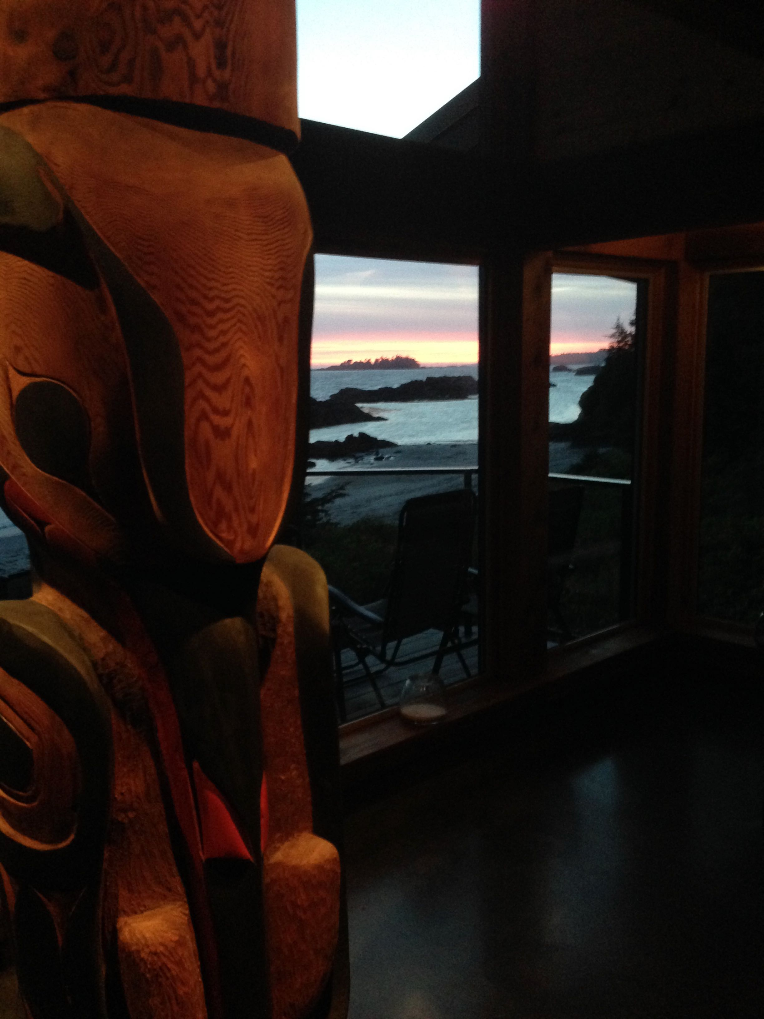
Indigenous Protected and Conserved Areas
IPCA’s can be advanced by:
1. Respecting and affirming Indigenous Protected Area designations.
Notes:
IPCA’s can be advanced by:
Respecting and affirming Indigenous Protected Area designations as a renewed basis for nation-to-nation cooperation in responsible stewardship, sustainable development, and conservation initiatives.
Legislative recognition of existing and emerging Indigenous designations by FPT governments;
Revisiting existing PA designations to recognize and create space for Indigenous jurisdictions.

Slide 19
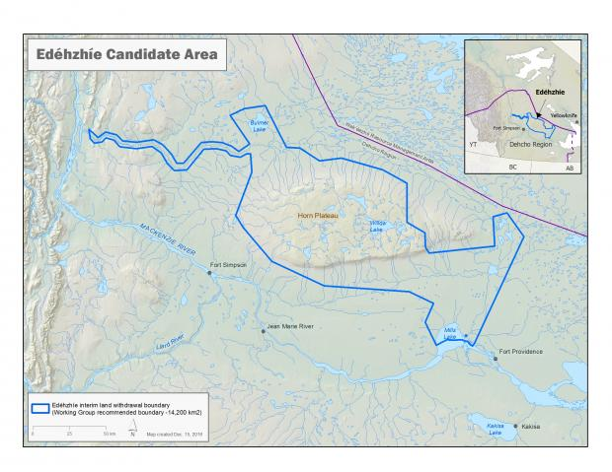
Indigenous Protected and Conserved Areas
IPCA’s can be advanced by:
2. supporting the development and implementation of a nationally coordinated network
Notes:
IPCAs can be advanced by:
supporting the development and implementation of a nationally coordinated network of Indigenous protected areas and Indigenous managers dedicated to the long term protection of ecological and cultural values that collectively contribute to the realization of national goals and Aichi international targets.
Collaborative, based on Nation-to-Nation and Crown-Inuit relationships.

Slide 20
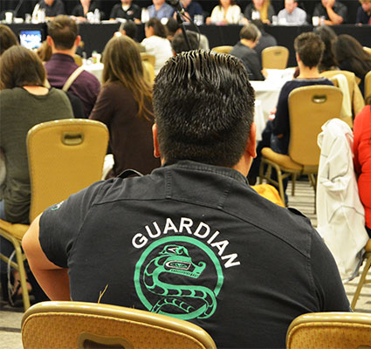
Indigenous Protected and Conserved Areas
IPCA’s can be advanced by:
3. supporting Indigenous Guardian programs
Notes:
supporting the direct contributions of Indigenous peoples in the stewardship and management of Indigenous Protected and Conserved Areas through Indigenous Guardians programs.

Slide 21
For more information:
Larry Innes Lorraine Land linnes@oktlaw.com lland@oktlaw.com

